Slide 1
Lex Automagica:
Blockchains & the Law
Blockchain & Legal Innovation I – Tutorial 1
Consensus Mechanisms

Slide 2
Consensus Mechanism
Proof of Work – accumulation of competitive brute force computing power to have greater chance of solving cryptographic puzzle
Proof of Stake – accumulation of brute force economic power to have greater chance of being selected to win block reward
UNL Consensus – 80% agreement among nodes that have chosen to trust each other

Slide 3
Proof of Work (BTC)
Pros
Secure
Competitive
Regulatory certainty
Good for “hard money”
Cons
Slow
Expensive
Economies of scale >> concentration
Bad for “smart money”

Slide 4
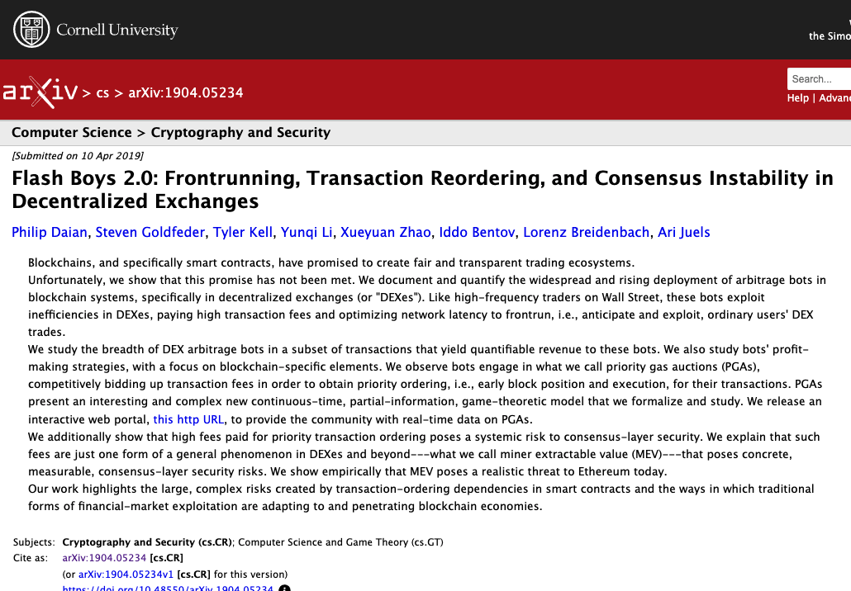
Miner Extracted Value
Miners have full autonomy in selecting which pending transactions in the mempool they will include in their block.
Miners can extract additional profits from users by taking advantage of their ability to arbitrarily reorder transactions, creating what is commonly known as miner-extractable value (MEV).
Most forms of MEV seen today are taken from third-party bots. These bots manipulate the ordering of their transaction within a block by changing the transaction fee they pay to miners. This means MEV can be extracted even when miners order transactions according to the highest gas prices.
Arbitrage – trading between two decentralised exchanges and paying high fees to make sure your transaction goes first.
Frontrunning – inserting a price-moving transaction ahead of another transaction to benefit from the slippage – the change in price caused by poor liquidity
https://arxiv.org/abs/1904.05234

Slide 5
Proof of Stake (ETH2)
Pros
Faster
Cheaper
Good for “smart money” or “smart contracts”
Cons
Regulatory uncertainty
Concentration
Artificial punishment
MEV with smart money
Bad for hard money

Slide 6
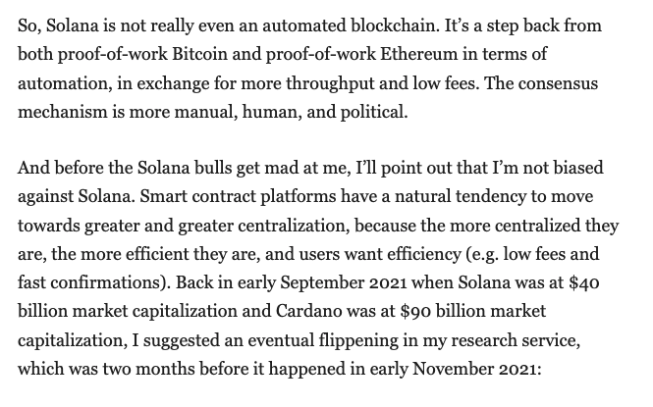
PoS = Security
Proof of Stake suits things that are more centralized
Proof of Stake more closely resembles traditional securities.
Proof of Stake requires the tokens will have value so that the cost of participating is real.
Proof of Stake more likely to be a managed investment scheme

Slide 7
UNL Consensus
Pros
Cheapest
Fastest
Preferences security over liveness
Cons
Need for dUNL to avoid forks
More human coordination
Looks more centralized

Slide 8
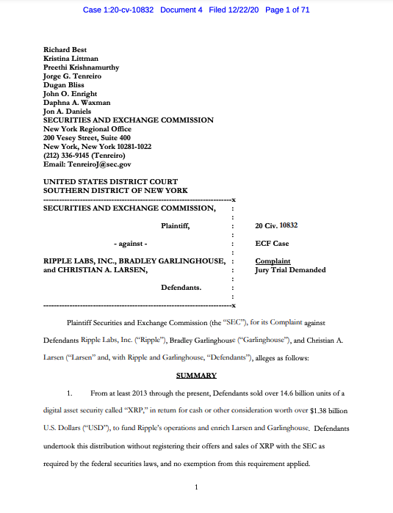
SEC v Ripple
Arises because:
Tokens are not mined, but are created at launch
dUNL is published by Ripple
Difficult Legal Issues
Perkins Coie 21 Page Advice
Perkins Coie 28 Page Advice

Slide 9
Summary
PoW is most certain, most costly, least flexible
PoS is uncertain, less costly, more flexible
UNL is least certain, least costly, most flexible

Slide 10
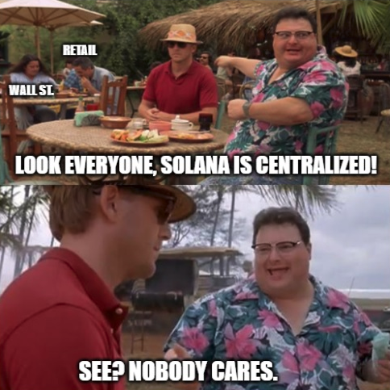
Does it Really Matter?
Decentralisation doesn’t seem to matter… except when it does.

Slide 11
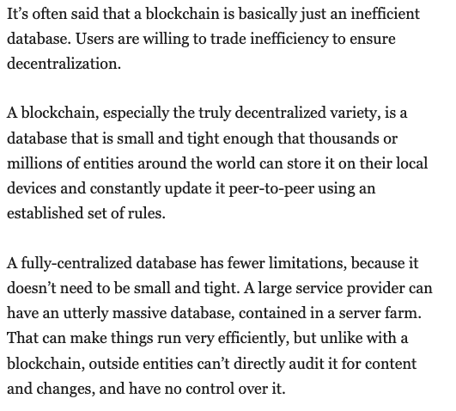
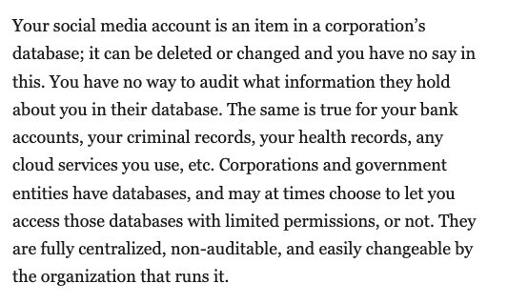
It’s All Trade-offs…

Slide 12
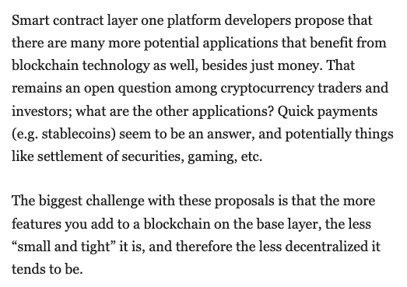
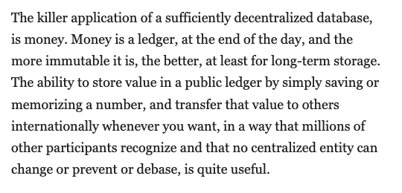
And trade-offs…

Slide 13
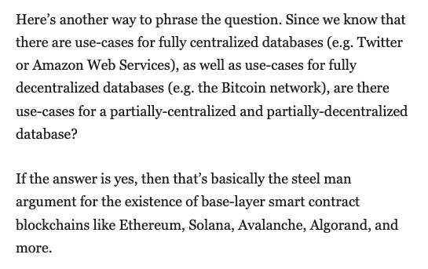
The Real Question…

Slide 14
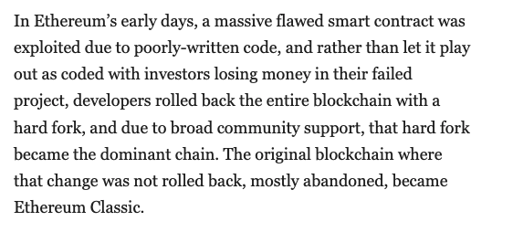
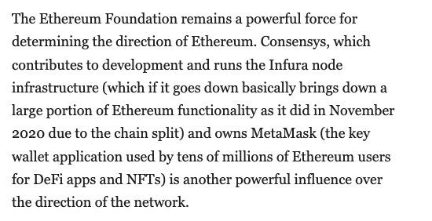
Implications?

Slide 15
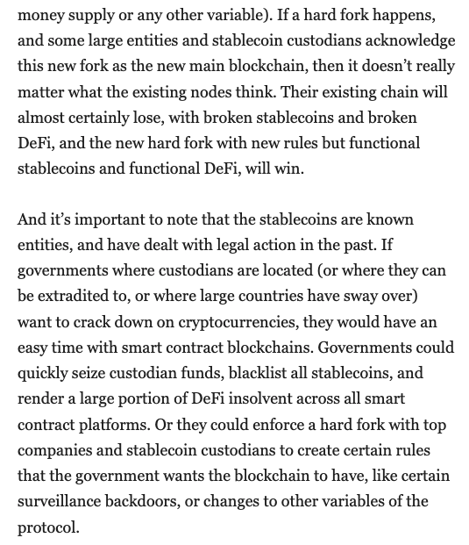
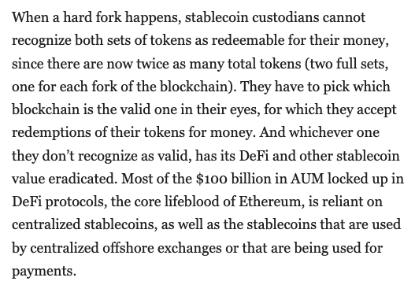
Even more implications…

Slide 16
Evernode Discussion
We faced all these issues with the design of our Evernode project
Smart contract platform
UNL consensus
How to structure the network…?

